Slide 1


Department of Computer Science Gujarat University
M.Sc.(Artificial Intelligence & Machine Learning) – I
Complaint management system
Under the Guidance of: Dr. Suchit Purohit
Presented by
Chauhan Harshil Shyambhai
Parmar Shreya Bhupendrabhai
Suthar Riya Manubhai

Slide 2

Introduction
The Complaint Management System is a software application designed to streamline the process of handling complaints within an educational institution.
It allows students, faculty, and administrators to manage and resolve complaints efficiently through a centralized digital platform.
The system ensures transparency, accountability, and faster resolution by tracking every complaint from submission to closure.

Slide 3
Research problem
Complaints are often handled manually, leading to delays in resolution.
Lack of a centralized system causes data loss and confusion.
No proper tracking of complaint status for students or faculty.
Poor communication between students, faculty, and administration.
Limited accountability, as responsibilities are not clearly defined.
Difficulty in analysing complaint trends or generating reports.

Slide 4
Objectives
The main goal of this system is to create an efficient, transparent, and organized way to manage complaints within the institution.
To digitize the complaint registration and resolution process.
To ensure transparency between students, faculty, and admin.
To track complaints and monitor their status in real time.
To assign responsibilities to the right authority (Admin, HOD, Faculty).
To reduce resolution time and improve communication.
To maintain records for future analysis and reporting.

Slide 5
Tech Stack
🖥️ Frontend:
Reat js, bootstrap, typescript
⚙️ Backend:
Python (Flask / Django) ,Django REST Framework, node js
🗄️ Database:
MongoDB, PostgreSQL
🧰 Tools & Others:
VS Code – Development Environment
GitHub – Version Control
Browser (Chrome / Brave) – Testing and Execution

Slide 6
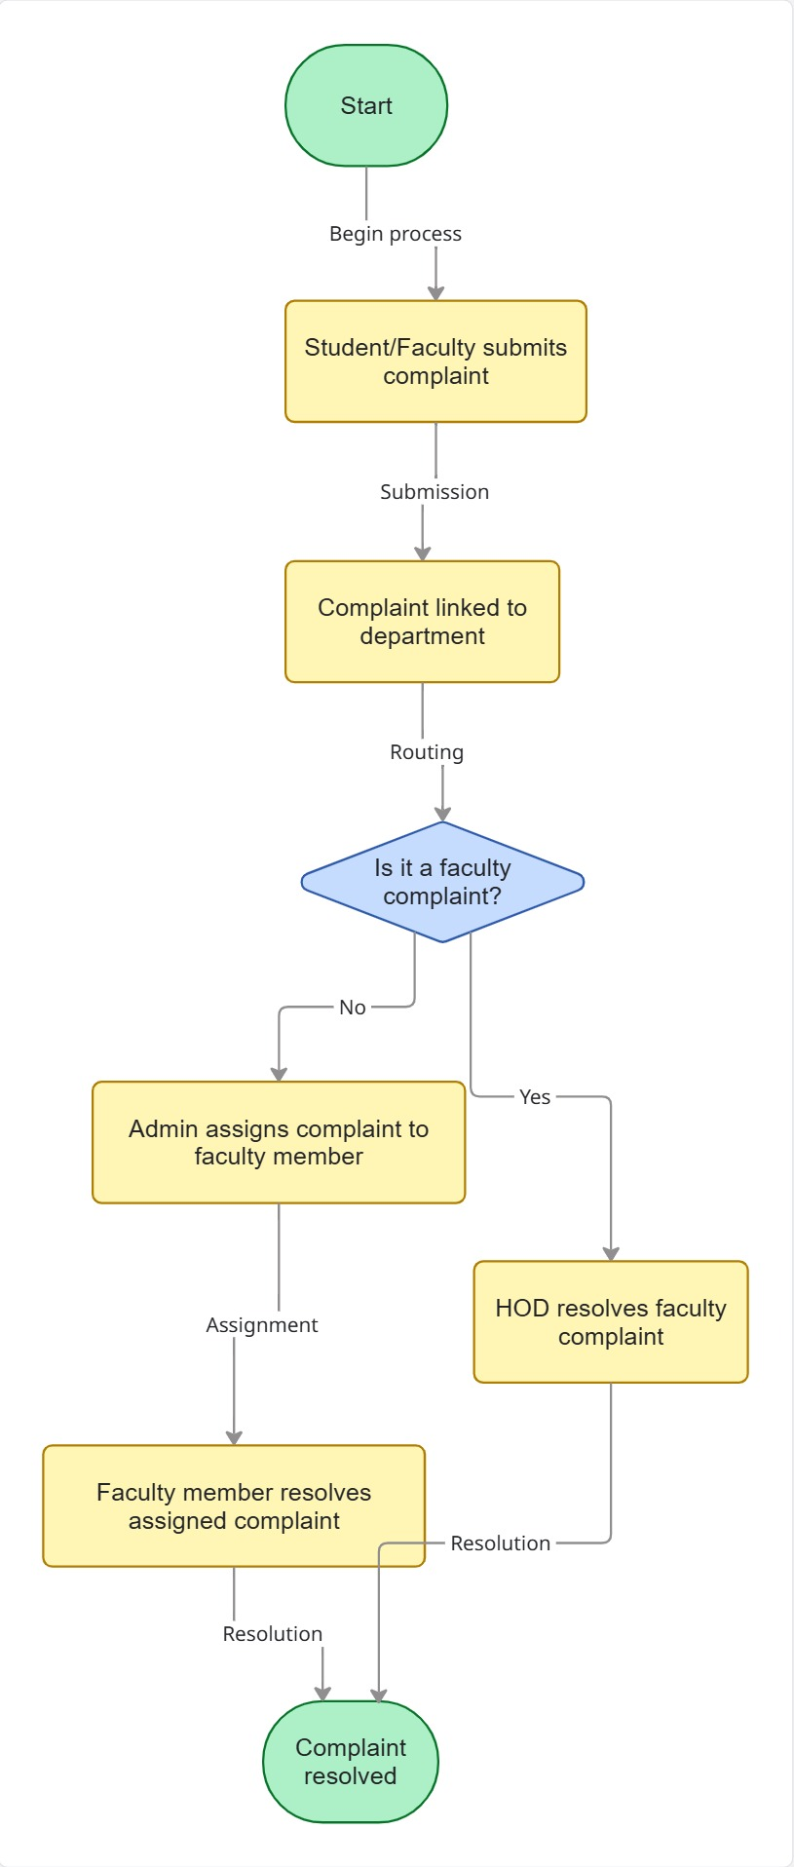
System Flow Diagram
Complaints submission and data capture
Review, assignment and action
Resolution and closure

Slide 7
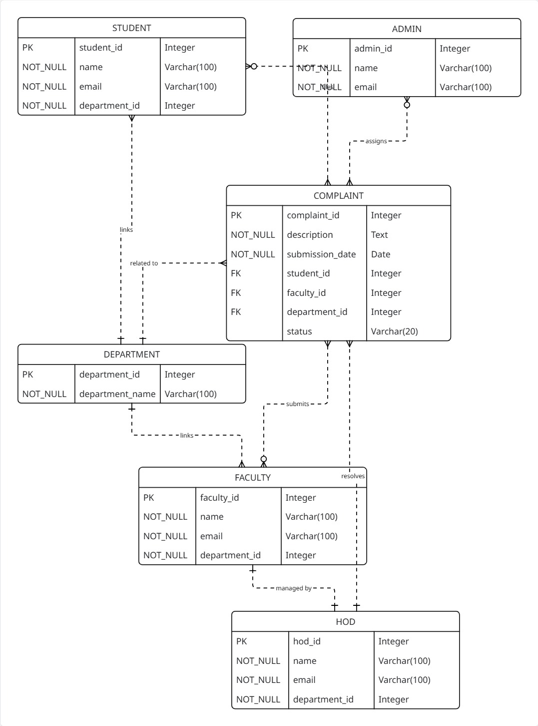
Entity-Relationship Diagram
The ER-Diagram connects students, Faculties, Admins, Departments and complaints within a compliant-management system.
Students and faculties submit their complaints, and each complaint is linked to a department.
Departments act as a common reference, linking students and faculty based on their department IDs.

Slide 8

Result
The system successfully improved and shortened the complaint resolution time.
All complaints were properly tracked and stored in the database.
Students and faculty reported improved communication and satisfaction.
The system achieved greater transparency and accountability in handling grievances.
Admins could easily monitor and assign complaints using the dashboard.
Resolved
pending
assigned

Slide 9





Discussion
The system effectively addressed the research question by improving efficiency, transparency, and accountability in complaint handling.
Digitalization led to a significant reduction in complaint resolution time and better record management.
Students and faculty experienced smoother communication and quicker responses.
Implications:
Need for automated workload balancing or notification system in future updates.
Importance of user awareness and training to ensure complete adoption.
Overall, the project proved that a Django-based complaint management system can make departmental grievance handling more structured, reliable, and transparent.

Slide 10
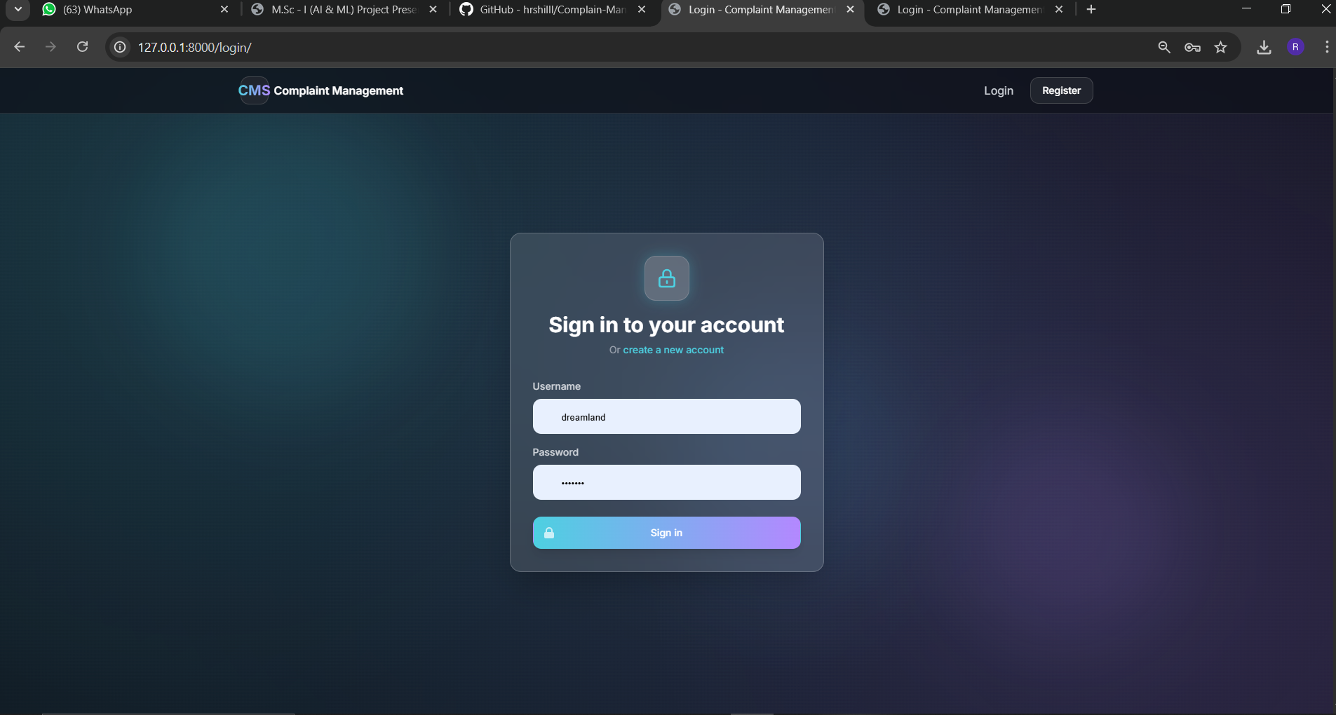
Login/Signup

Slide 11
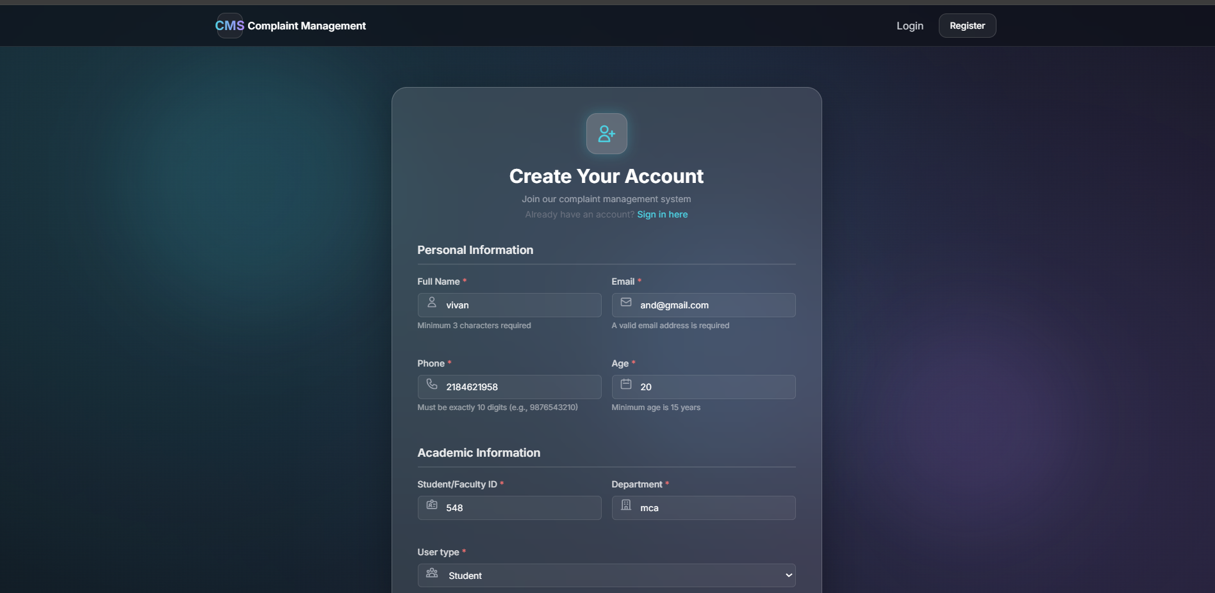
Registration

Slide 12
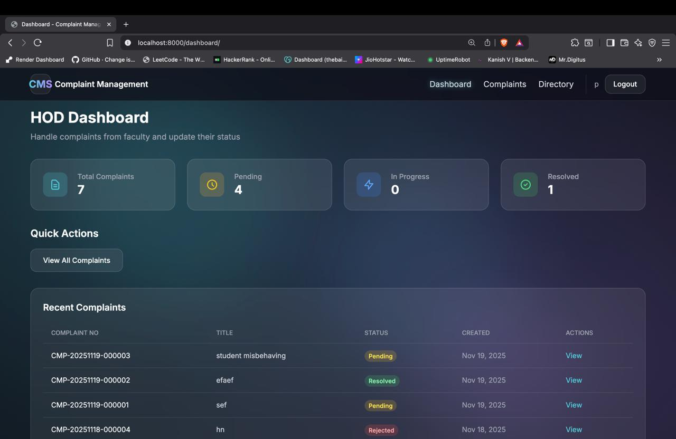
HOD Dashboard

Slide 13
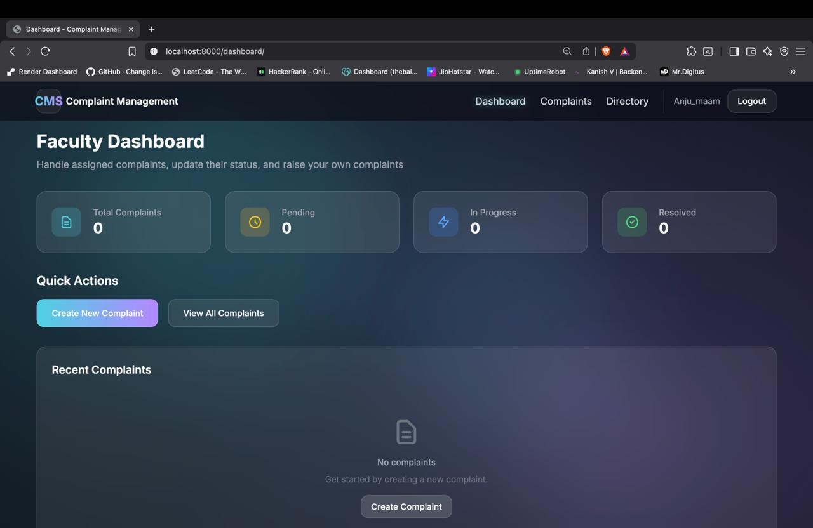
Faculty Dashboard

Slide 14
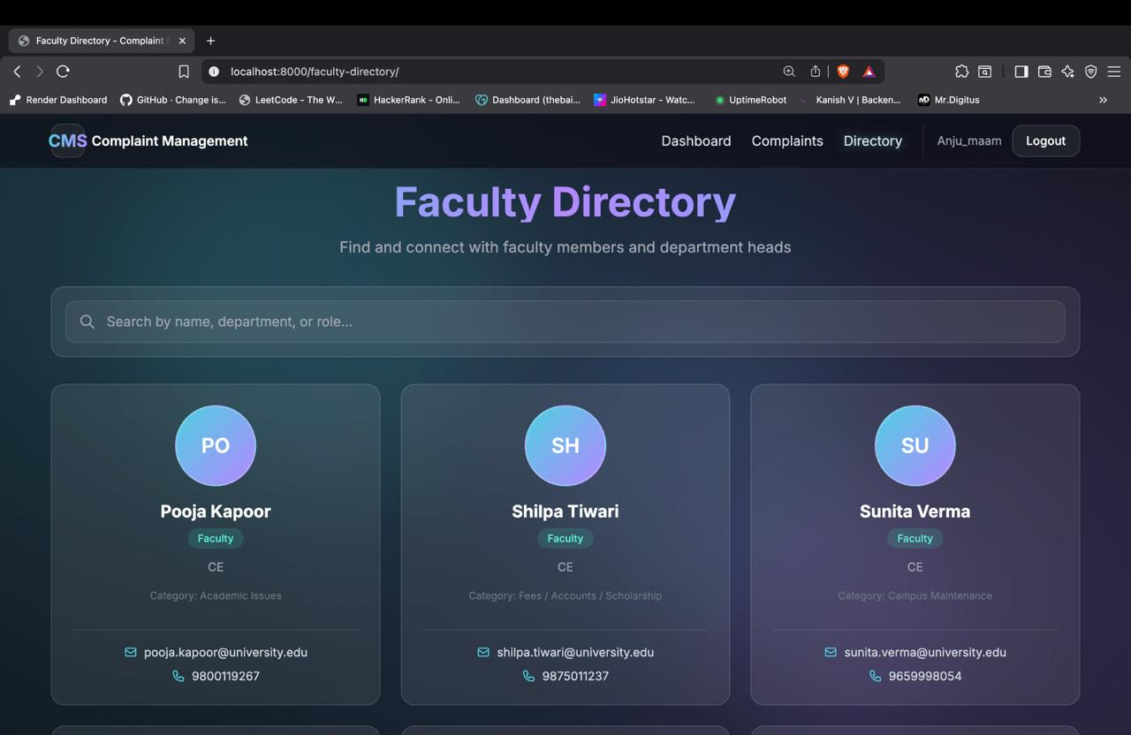

Slide 15
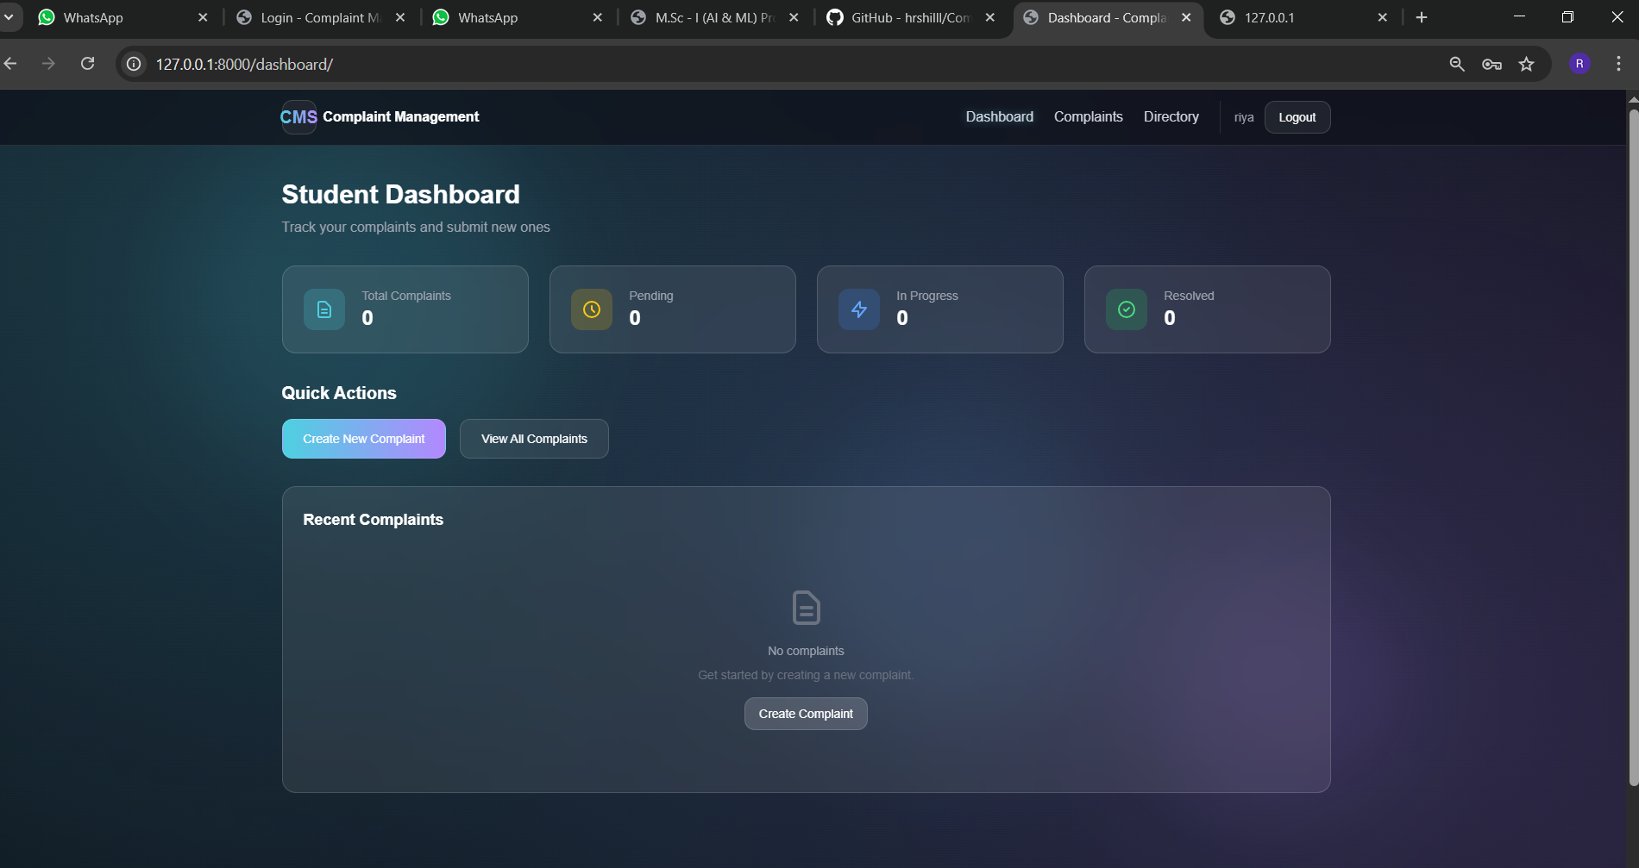
Student Dashboard

Slide 16
Limitations
The system was tested with a limited number of users, so large-scale performance wasn’t fully evaluated.
Short development time restricted the addition of advanced features like notifications and file attachments.
The system requires internet access, which may limit usability in offline environments.
Some data, such as initial complaints, had to be entered manually during testing.
Scalability and security testing were limited due to time and resource constraints.
These limitations may have slightly influenced the accuracy of performance evaluation and user experience testing.

Slide 17
Future Work
Add email or SMS notifications to alert users about complaint updates.
Develop a mobile-friendly version or dedicated mobile app for easier access.
Implement data analytics dashboard for admins to monitor complaint trends and performance.
Introduce AI-based categorization to automatically assign complaints to the relevant faculty.
Add a feedback and rating system for users to evaluate complaint resolution.
Improve security and scalability for deployment across multiple departments or institutions.
integrate chat support or chatbot for instant query assistance.

Slide 18
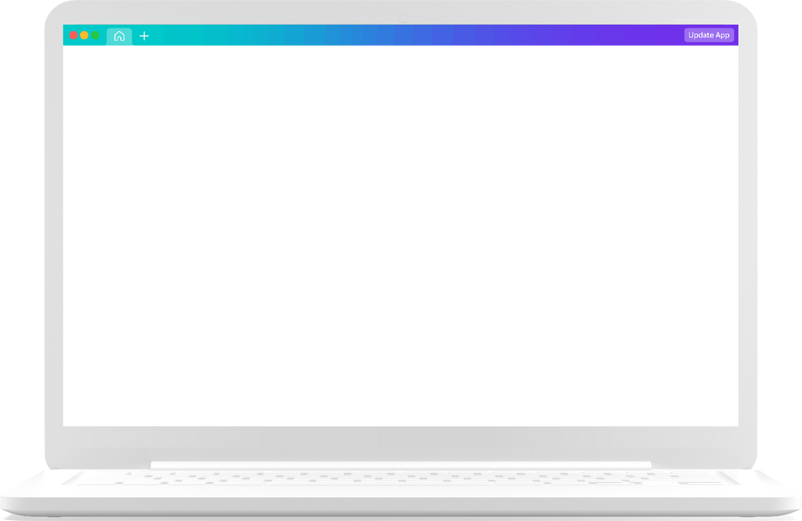

Conclusion
The project successfully developed a Django-based Complaint Management System for academic use.
It digitalized and streamlined the complaint process, making it more efficient and transparent.
Students, faculty, and administrators benefited from role-based access and improved communication.
The system significantly reduced complaint resolution time and improved record management.
Findings highlight the importance of technology in enhancing accountability and efficiency in institutions.
The project lays a strong foundation for future enhancements and broader implementation across departments.

Slide 19
Thank you very much!

